Slide 1
The Imagination Economy:
Sri Lanka’s Industry of the Future
SLASSCOM Overview

Slide 2
What’s SLASSCOM?

Slide 3
About SLASSCOM
Sri Lanka Association for Software and Services Companies - chamber for the knowledge services industry
Over 200 members who account for 90%+ of Sri Lanka’s IT exports
Industry export revenue estimated USD 1.2 billion in 2017
IT/BPM ranks #5 on national export revenues
IT/BPM is one of six sectors promoted by the National Export Strategy (NES)

Slide 4
SLASSCOM Board & General Council 2018/19
Chairman
Ranil Rajapakse
Vice Chairman - 1
Channa Manoharan
Vice Chairman - 2
Sandra De Zoysa
Director Operations
Ashique Ali
Director Finance
Shevan Goonetilleke
Directors
Rasika Karunatilake
Nishan Mendis
Hasith Yaggahawita
Nuwan Perera
Haridhu Abeygoonaratne
Chandi Dharmaratne
Srikanthan Jayarajah
General Council
18 members

Slide 5
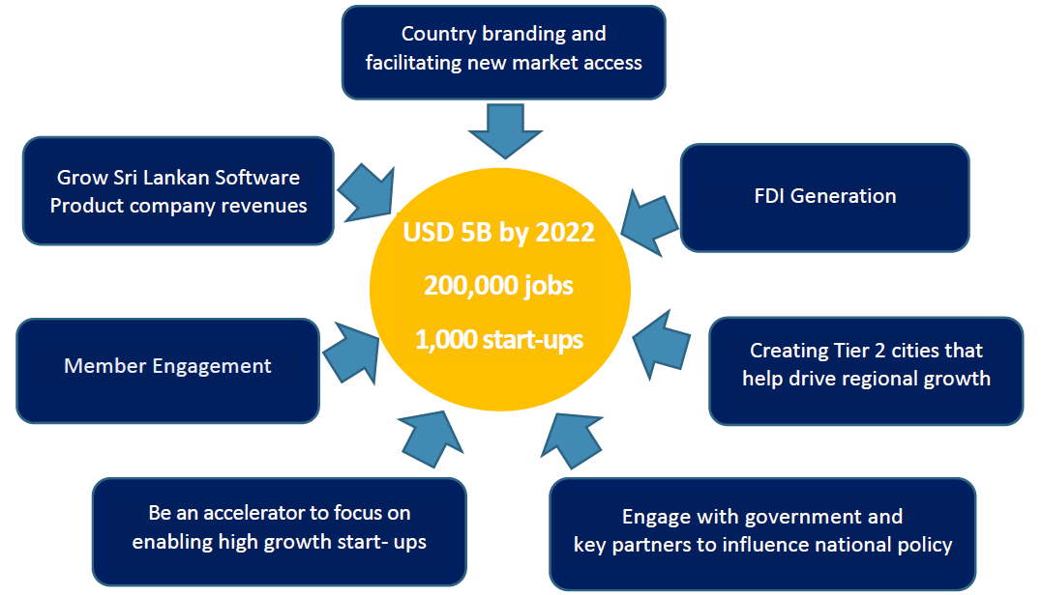
SLASSCOM – Core objectives

Slide 6
Our vision and mission
Vision - #1 Industry
Knowledge and Innovation Industry to become the #1 revenue earner for Sri Lanka in the next 10 years
Approach
- Build on niche focus areas of strength to create “Captive Innovation Centers”
- Position as the “Digital Gateway to Asia” to attract Western FDI
- Enable more IP and Product creation to retain higher value in
Sri Lanka
Mission
SLASSCOM acts as the catalyst of growth for the Sri Lankan knowledge and innovation (IT and BPM) industry by facilitating trade and business, propagation of education and employment, encouragement of research and innovation, and by supporting the creation of a progressive national policy framework

Slide 7
Outcomes
Deliver a significant % of the country’s growth agenda
2022 Knowledge Service Industry Goals
US $5 Bn export revenue
200,000 high paying knowledge worker jobs
Vibrant startup ecosystem with 1,000+ companies
High paying knowledge worker jobs with average salary of over $1,200 per month
15%
of national exports goal
Over 95% value addition will disproportionately stimulate Economy
13%
of national new employment goals
For each IT/BPM job, 2.5 indirect jobs, creating a force multiplier
10%
of national FDI goals

Slide 8
SLASSCOM Community Forums
Marketing
Technology
Policy
Quality
Capacity Building
Human Resource
Business Process Management
Entrepreneurship
Regional Development
Innovation

Slide 9
SLASSCOM Community Forums
Marketing Forum: Positioning Sri Lanka's competitive advantage among key markets, increasing global market share and FDI
Country branding
Participating in trade shows
BPM Forum: Building BPM capacity, market share and FDI in niche areas Sri Lanka can sustain a competitive advantage
Quarterly Knowledge sharing Session
BPM Conference
White paper on changes required in shop and office act to help develop and sustain industry

Slide 10
SLASSCOM Community Forums
Technology Forum: Develop technical skills and capability towards high demand and emerging technologies
Quarterly tech talks on upcoming technological advancements
AI summit
Hot skills survey and round table
Quality Forum: Develop competencies on software quality assurance and testing
Monthly quality talks
University reach program to introduce Quality Assurance Engineering as a subject in university curriculum
Quality summit

Slide 11
SLASSCOM Community Forums
Entrepreneurship Forum: Initiate, incubate and accelerate disruptive innovative product start-ups
Bi monthly mentoring sessions
Partner in global startup programs eg- slush, Oslo Innovation Week and SeedStars
Innovation Forum: Showcase technical and product innovations to position Sri Lanka as a R&D, product engineering destination
Innovation awards
Regional Growth: Take IT/BPM to the regions/Tier 2 cities to grow and sustain the industry
Kandy, Matara, Kurunegala & Jaffna
Focus areas - 3 year business plan, Technology, Marketing, People management, Finance & Internal Processes

Slide 12
SLASSCOM Community Forums
HR Forum: Enable the HR community to learn and adopt the best people practices
Industry compensation and benefits survey
People summit to introduce latest people management practices in the world to SL
Undergraduate Employability Program
Work In Sri Lanka program
Quarterly HR talks
Women in IT/BPM initiatives
Capacity Forum: Develop priority skills and scale, drive the national IT/BPM strategy
ICT teacher training sessions
Future Careers Elevator program
Education Reforms to update school curriculum
Regionall IT-BPM programs to reach school kids

Slide 13
Thank you.

